Slide 1
Creepiness Metric and LSTM
Anthony
11/16/2020

Slide 2
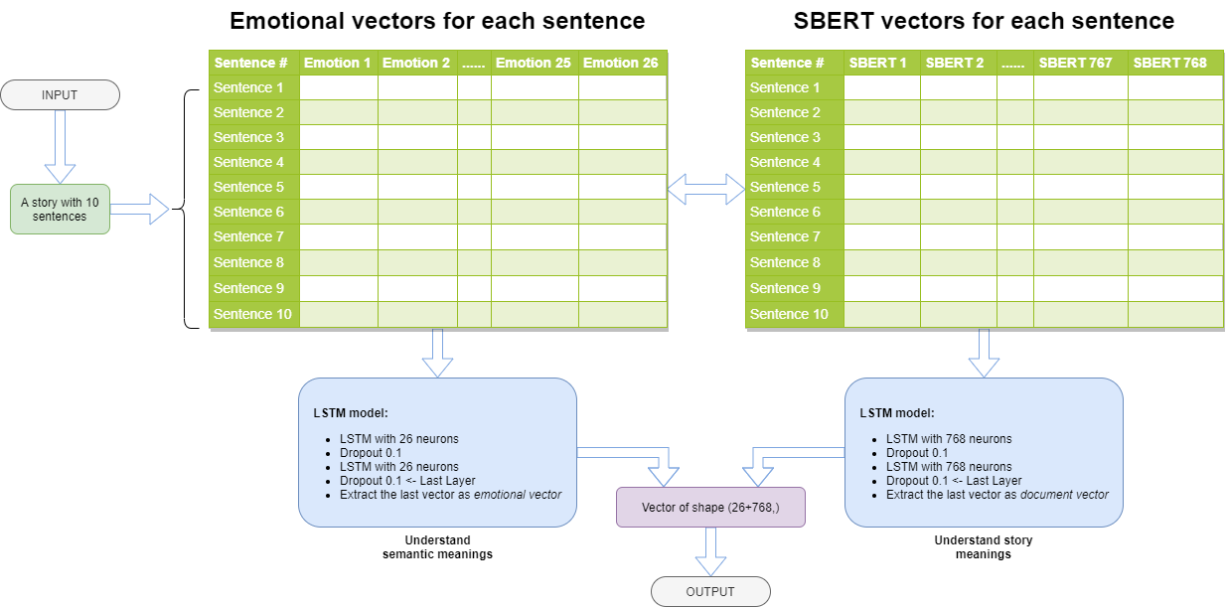

Slide 3
How do we know what emotions to choose from?
“Self-report captures 27 distinct categories of emotion bridged by continuous gradients” by Alan S. Cowen and Dacher Keltner in September 2017
https://www.pnas.org/content/114/38/E7900
27 emotions: admiration, adoration, aesthetic appreciation, amusement, anger, anxiety, awe, awkwardness, boredom, calmness, confusion, craving, disgust, empathic pain, entrancement, excitement, fear, horror, interest, joy, nostalgia, relief, romance, sadness, satisfaction, sexual desire, surprise
Cosine similarity between emotions and sentences

Slide 4
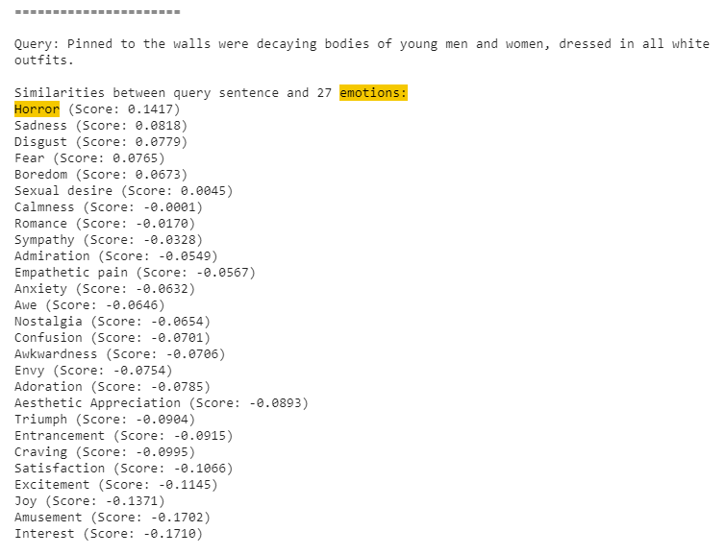
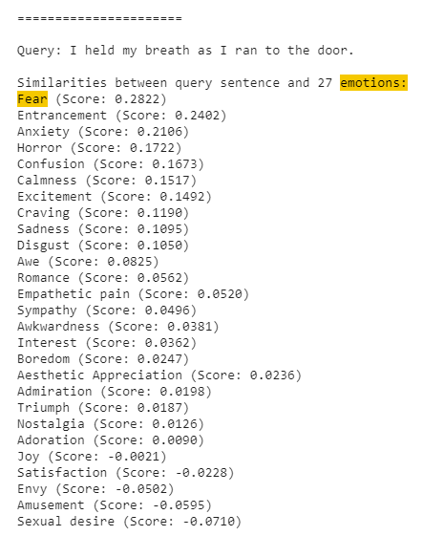

Slide 5
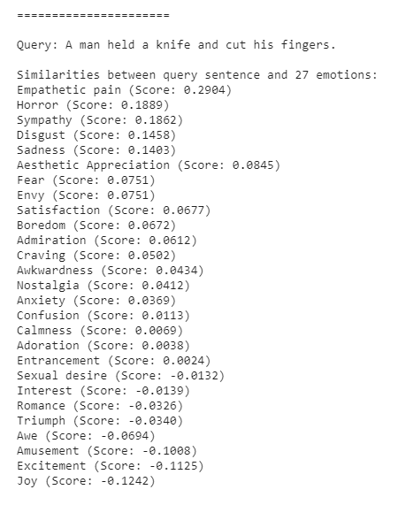
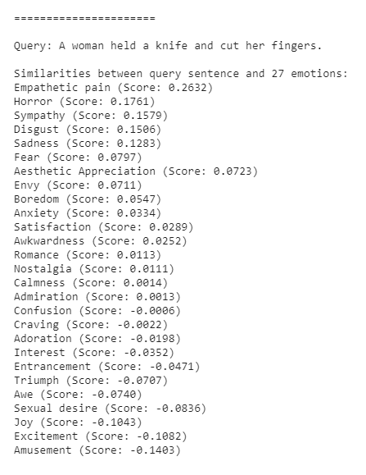
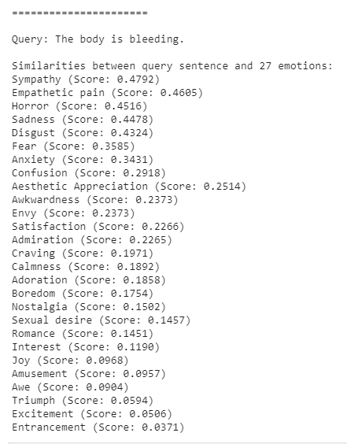

Slide 6
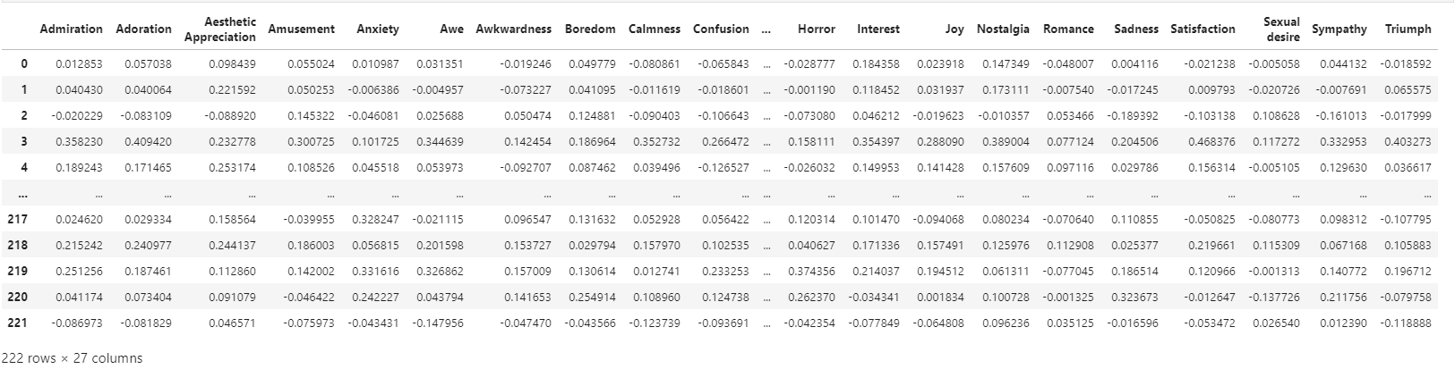

Slide 7
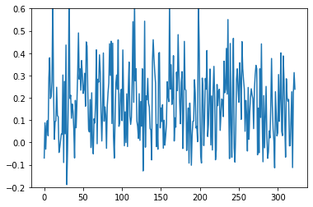
Horror level across a story
A story from nosleep with 303 sentences
The most upvoted story in the dataset

Slide 8
sentences of a story

Slide 9
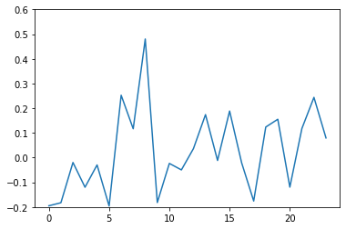
Horror level across a story
A story from confessions with 24 sentences
The most upvoted story in the dataset

Slide 10
sentences of a story

Slide 11
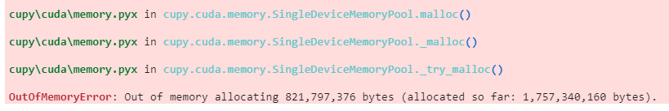
Problems
HUGE memory consumptions
16G of RAM and 8G of VRAM
0.821797376 Gigabytes
1.75734016 Gigabyte

